Slide 1


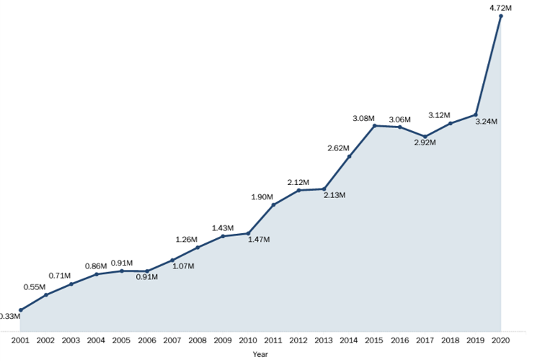
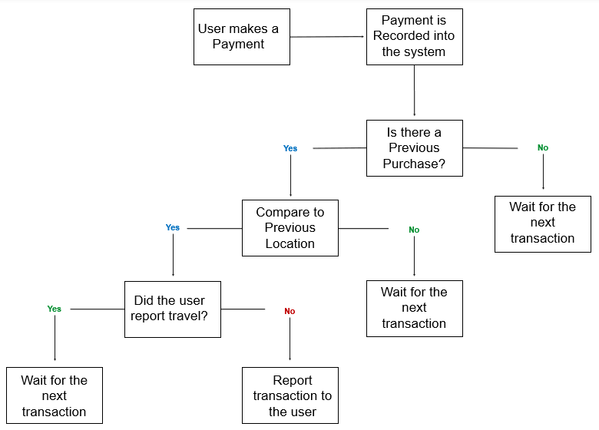
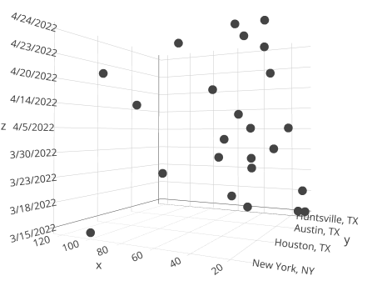
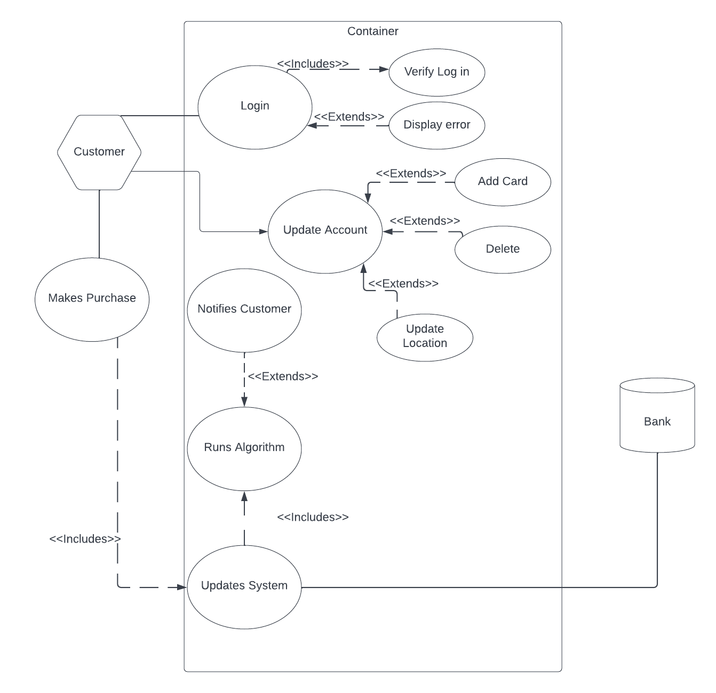
CREDIT CARD FRAUD DETECTION WEDSITE Group Members: Amanda Hayden, LOUANNE MOZER-SALLO, Jonathan Ochoa, FRANKIE VELEZ, with faculty support from DR. ABm Islam
Introduction
Objective
Proposed Method
Conclusion and Future Works
[1] The Federal Trade Commision report the following in 2020:
2.1 million cases of credit card fraud
Over $3.3 Billion in fraud reimbursement
Credit Card Fraud is an important issues that causes undue stress and possible financial ruin to its victims
To produce an easy to use and secure website that will allow users to stay up to date with all of their credit cards, and alert users of suspicious purchases.
Functional Requirements:
Connection between Main program and SQL Database
Security of User's Data must take priority
Must have an algorithm that will detect suspicious purchases
Nonfunctional Requirements:
Support by the a typical user's browser
Visual design will prioritize ease of use and quality UI
Optimize technical standards for best user experience
Website
Blazor with .NET API
Dapper for Database Connection
Security
AES-256 Encryption on Database
Password requires 6 characters, 1 number, and 1 special character
Dual Authentication to access user account.
Detection
Comparison between User, net location, and the location of the purchase.
A proper conclusion could not be at the time made on the effectiveness of the proposed method, since proper testing was not completed.
Future works will include:
Proper testing of original work
Implementation of an unsupervised machine learning
K-mean clustering algorithm with three variables ( Location, data, and transaction amount)
Better visualization for user
Figure 1: Graph depicting the rise in Credit Card Fraud
Related Works
There are several Identify Theft Protection and Expense tracking software available. They usually suffer at least one of the following problems:
Usually cost money,
Are slow because of their reliance on monthly credit reports, or
Don't notify users of suspicious purchases
Figure 3: Proposed Data Flow Diagram
Figure 4: Concept for scatter plot created for clustering
Results
References
The following aspects of the project were considered a success:
User Interface
Security, with Dual Authentication
The results of the Algorithm is not available but the proposed system would have increased decision complexity compared to other options.
[1]“New Data Shows FTC received 2.2 million fraud reports from consumers in 2020,” Federal Trade Commission, 24-Aug-2021. [Online]. Available: https://www.ftc.gov/news-events/news/press-releases/2021/02/new-data-shows-ftc-received-22-million-fraud-reports-consumers-2020. [Accessed: 05-May-2022].
Figure 2: Proposed Use Case

